Slide 1
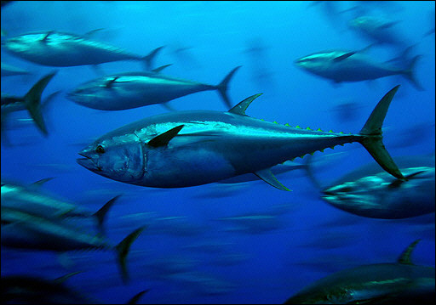





D A Kiefer, D P Harrison, M G Hinton, S Kohin, E M Armstrong, F J O’Brien
“NASA Biodiversity & Ecological Forecastin Team Meeting ”
25-27 April 2012 in Seattle.
Pelagic Habitat Analysis Module (PHAM) for GIS Based
Fisheries Decision Support

Slide 2
Pelagic Habitat Analysis Module (PHAM)
Fisheries Catch/Survey Data:
IATTC, SWFSC
Tagging Data: FishTracker, Tagbase
Satellite Imagery:
SSH,SSChl,SST
Circulation Model:
ECCO-2
EASy GIS
PHAM Tools & Statistics
visit runeasy.com
Dynamic Maps of Habitat
Data & Results of Statistical Analysis

Slide 3
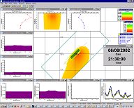
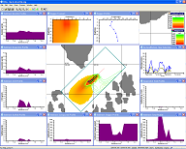
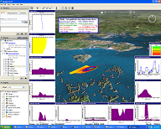
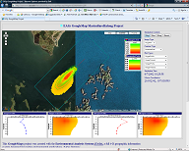
EASy Spatial Analysis Architecture
Desktop
EOF XLS
Reg. Data
Custom Data
NetViewer
Spatial Analysis
Service
Data File
‘R’
GoogleEarth
EASy
PNG File
Batch File
Script File
GE/GM
Imagery
Database
GoogleMaps
‘R’ Interface
GE/GM Files
EASy Infrastructure
Google PHAMLite

Slide 4
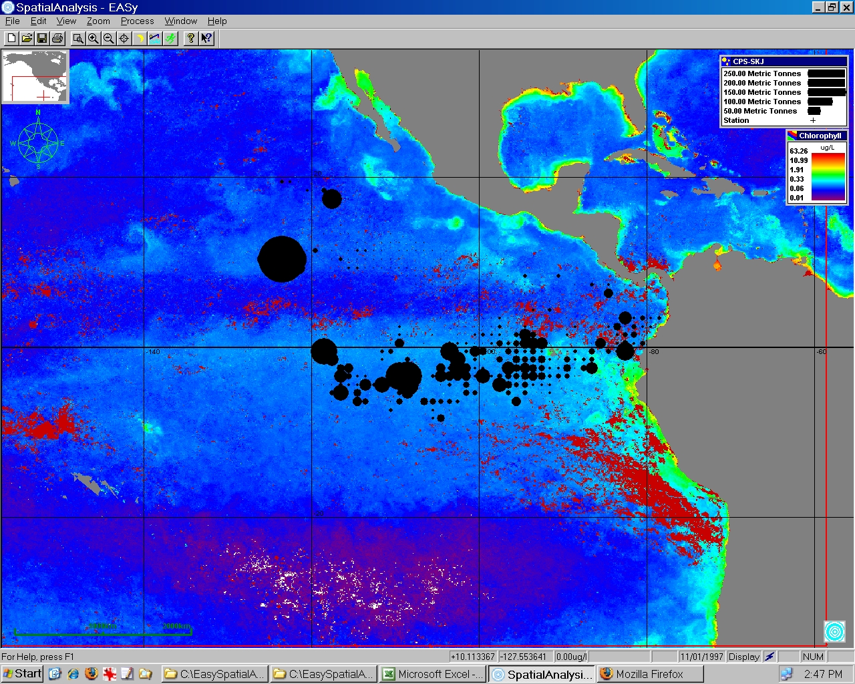
PHAM blob plot of skipjack catch per set during 1997 El Nino superimposed upon SEAWiFS imagery of sea surface chlorophyll. Note movement of catch to the north of northern fish, general decrease in concentration of chlorophyll, and extremely clear and unproductive water at convergence zone at 5 N.

Slide 5
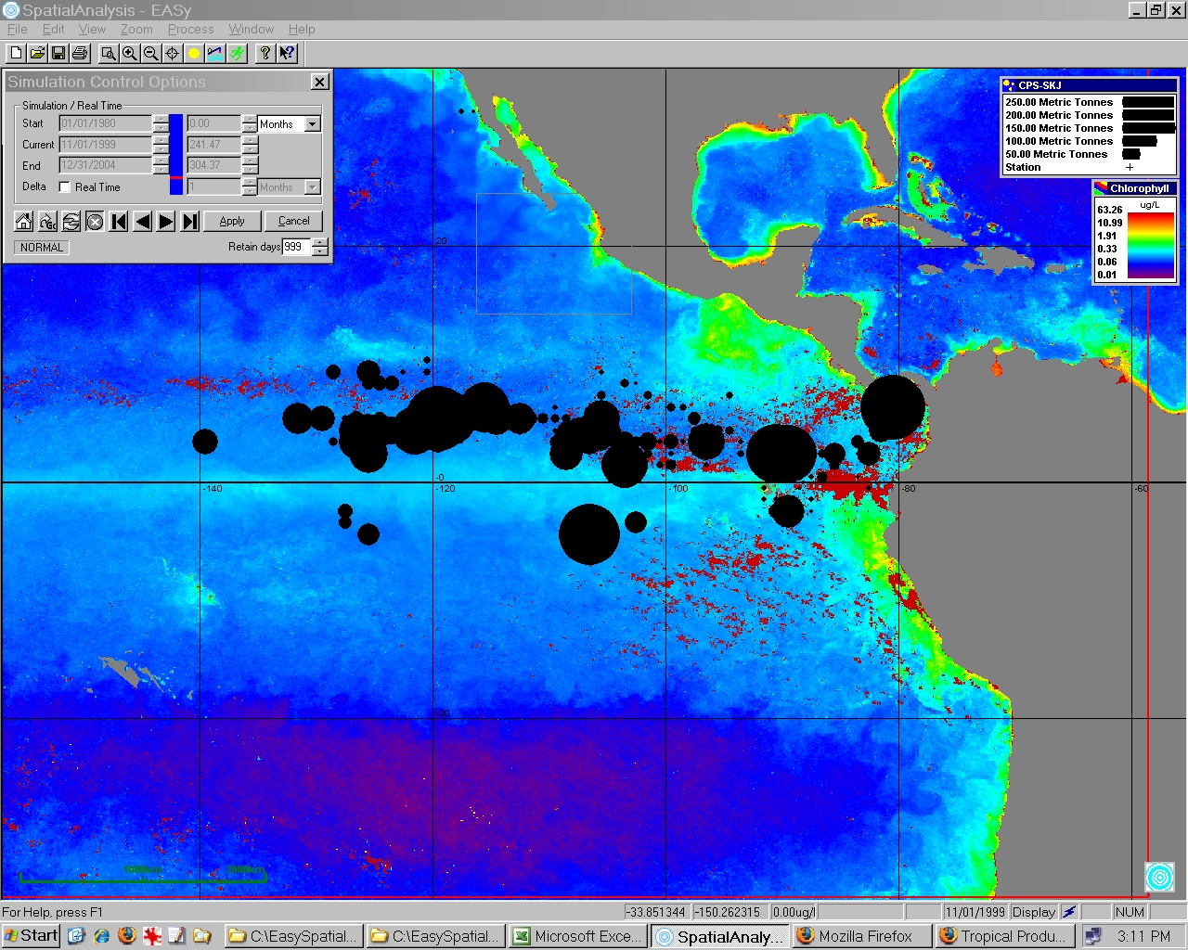
PHAM blob plot of skipjack catch per set during 1999 La Nina superimposed upon SEAWiFS imagery of sea surface chlorophyll. Note movement of catch towards equator, general increase in concentration of chlorophyll, and disappearance of clear and unproductive water at 5 N.

Slide 6
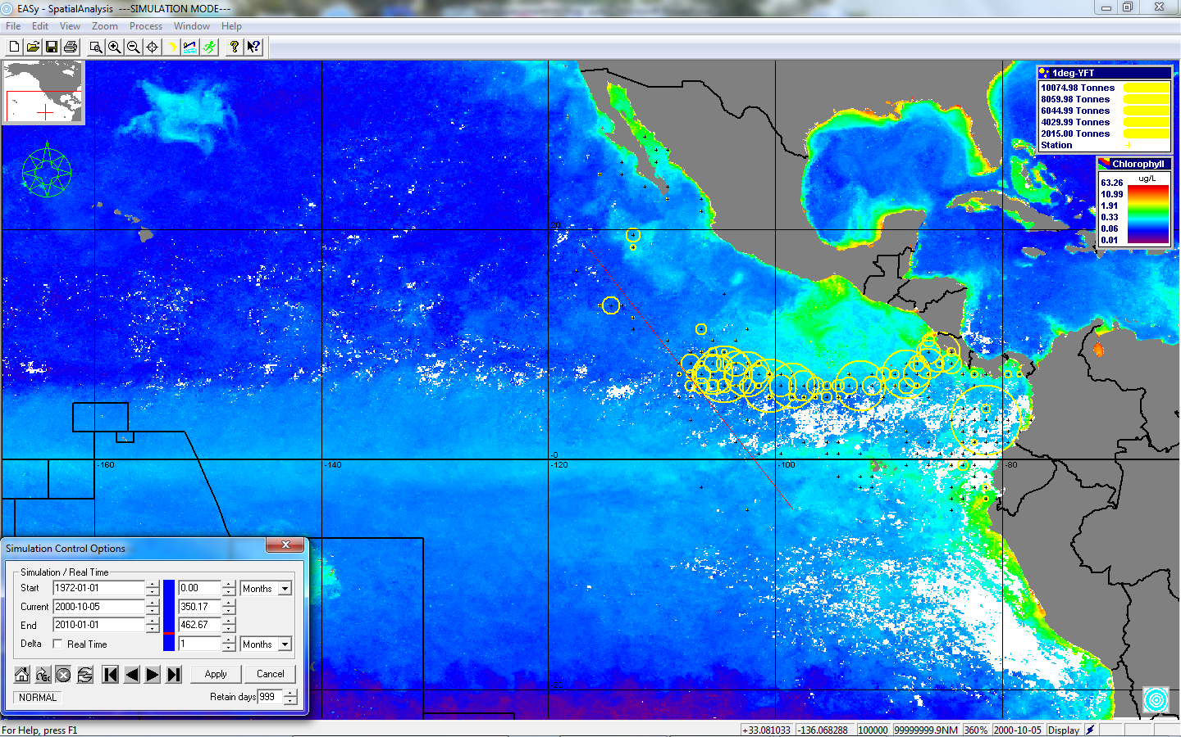
Time Series Runs: Yellowfin Catch along Color Front

Slide 7
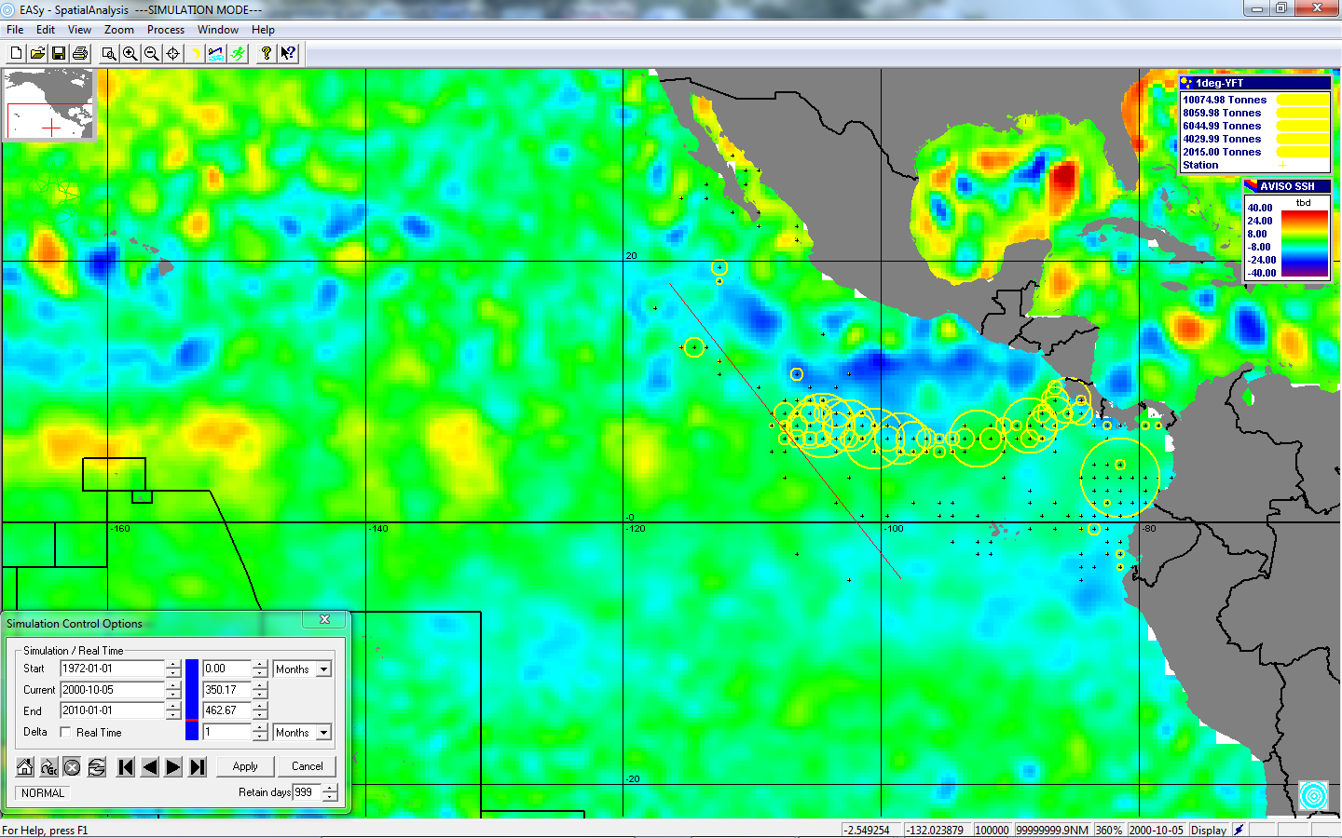
Time Series Runs: Yellowfin Catch along Eddy Front ?

Slide 8
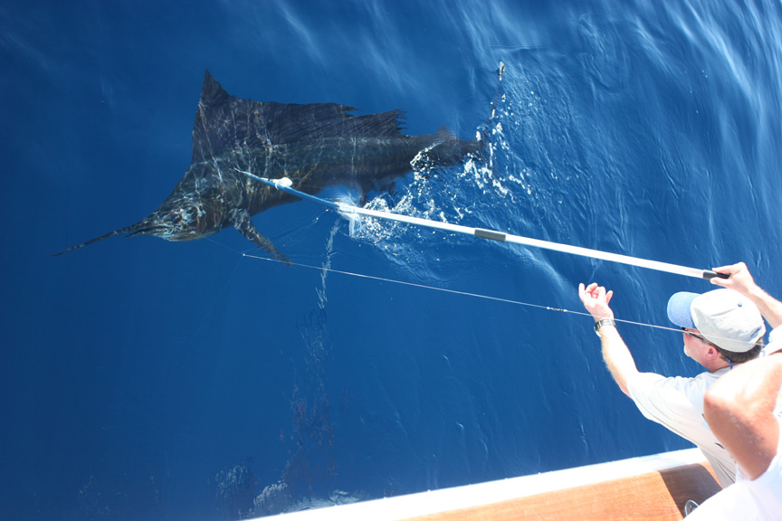
Using electronic tagging data to estimate movement, identify habitat, and characterize behavior of marine pelagic predators
Goals of thesis
  Develop visualization tools & analytical methods for electronical tag data
  Apply to two species (striped marlin, great white shark) to investigate three-dimensional movements in relation to their short-and long-term life history strategies in the environment
Michael Domeier
Marine Conservation Science Institute

Slide 9
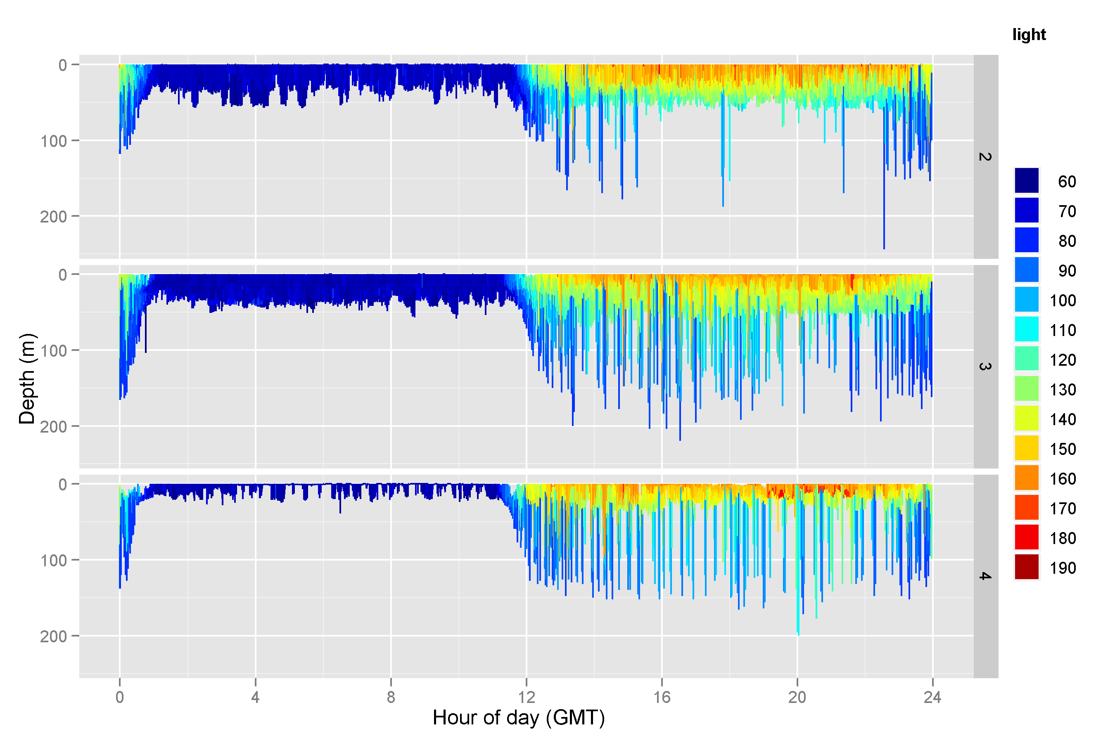
Light level
Eastern Pacific
sunset
sunrise
Day Night Day
Cri-16

Slide 10
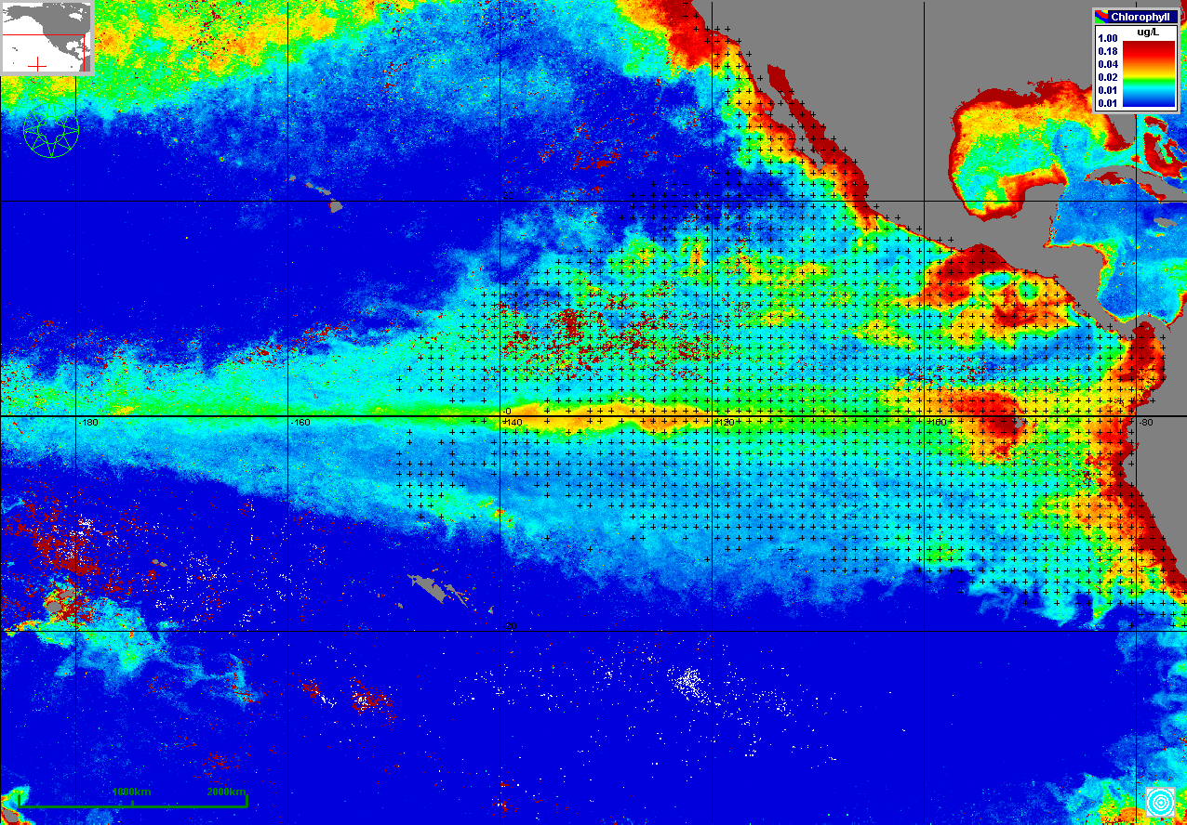
MODIS. Chlorophyll. February 2007

Slide 11
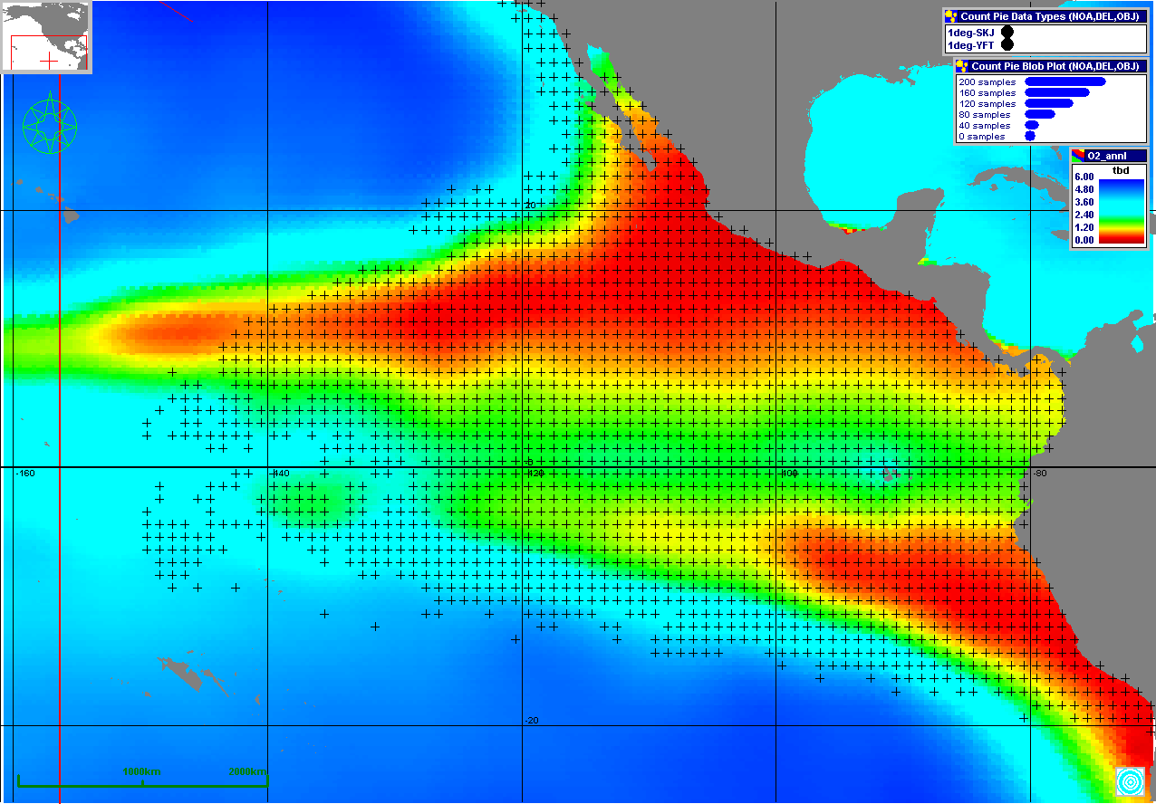
Annual Average O2 at 150 m

Slide 12
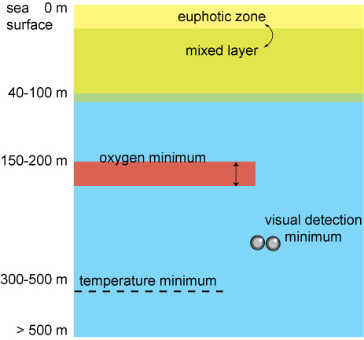
Vertical structure in the daily search for prey

Slide 13
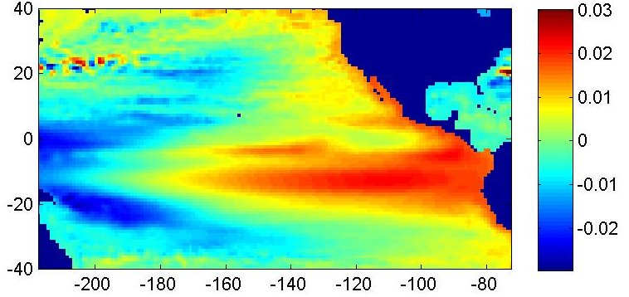
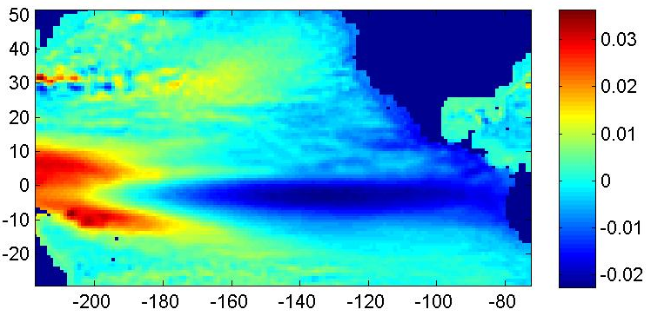
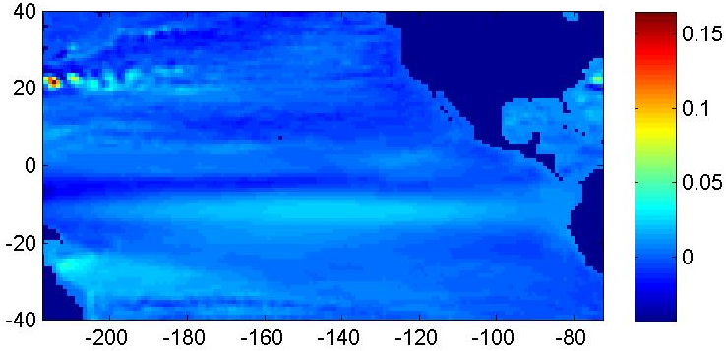
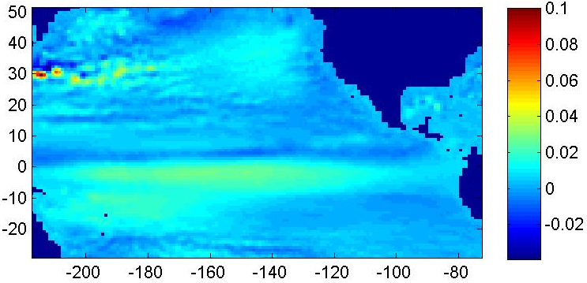
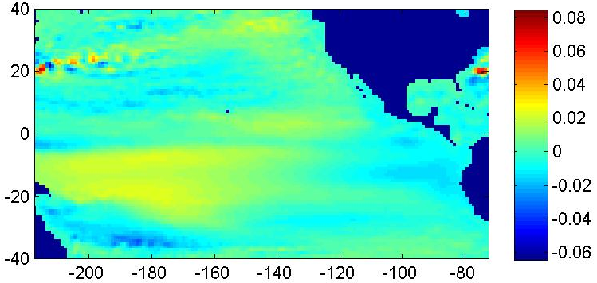
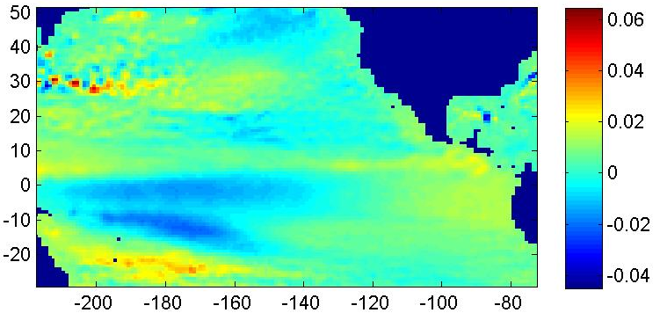
Cube 92
Aviso SSH

Slide 14
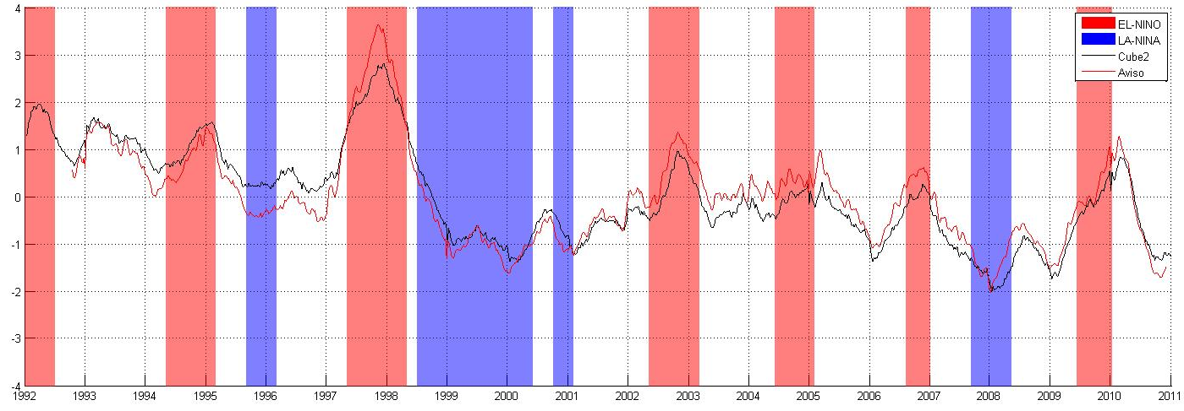
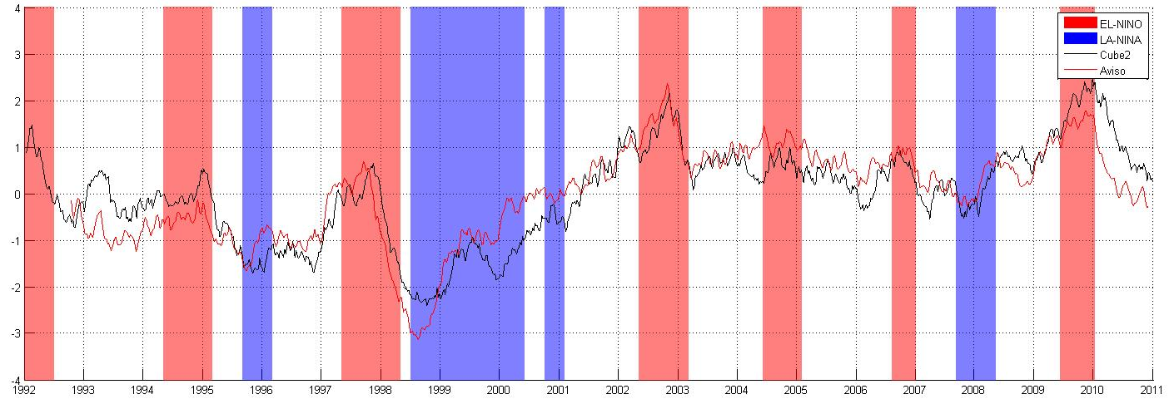
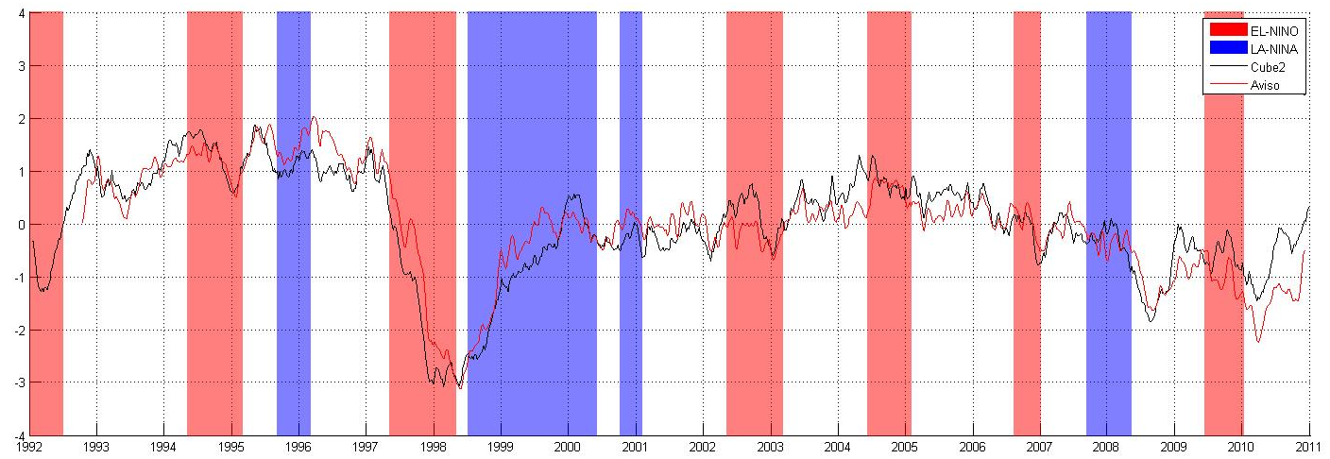
EOF and Linkage to Global Circulation Models
Cube92PC 1: 16.54%
AvisoPC1: 14.31%
Cube92PC 1: 6.16%
AvisoPC1: 6.81%
Cube92PC3: 5.08%
AvisoPC3: 4.43%
Notes:
Comparison

Slide 15
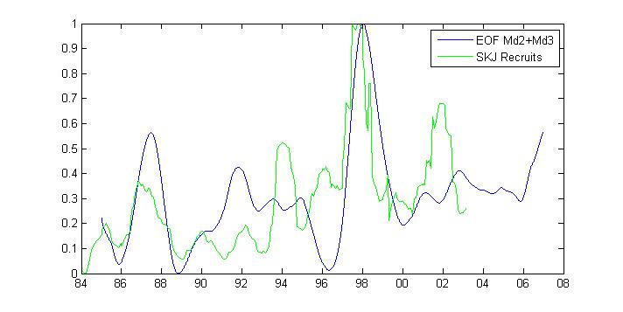
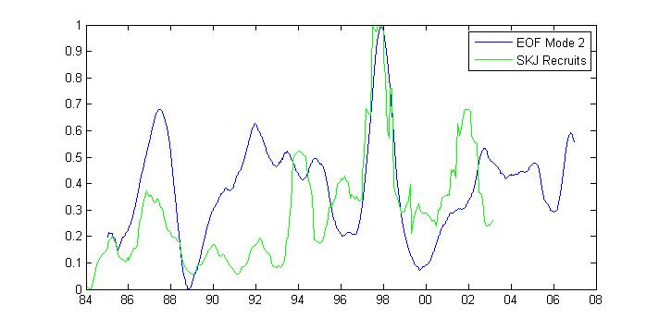
The temporal expansion coefficients for mode 2 and 3 closely track the recruitment of skipjack as well as the bigeye and yellowfin tuna. It appears likely that such information will provide new and improved estimates for the stock assessment models.

Slide 16
Conclusions
Software Development
PHAM-R interface expanded
  EOF analysis of satellite imagery
  GAM Habitat Modeling
Launching JPL Netviewer,
Stock Assessment Models a challenge but … PHAM international
workshops
Dynamics of Coupled Natural and Human System: Individual based modeling from tuna distribution to fleet operations to fishery management- driven by satellite SST, SSChl, and SSH
Scientific Insights
Established influence of ENSO perturbations on tuna recruitment & stock
assessment
Tracking of fleet movements with fronts and eddies
Linkage between depth of hypoxic waters and tuna fishing grounds-
predictions of industrial response to climate change.
Climate change and EOF series.
Validation of ECCO-2 (currents & phytoplankton)/SSH Imagery

